Slide 1
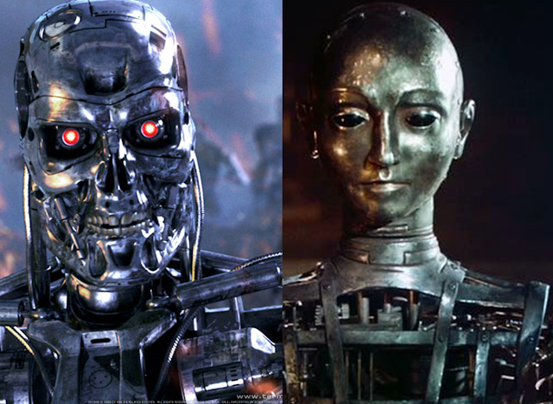
Theory Of Automata
1
Notes:
22

Slide 2
Lecture # 06
Theory of Automata
2

Slide 3
Revision
Concatenation of strings
Language Concatenation
Union of strings
Regular expressions
Conversion of string in to Regular expressions
Examples of RE
2

Slide 4
1:Concatenation of Strings
◦ is the concatenation operator
Example:
Suppose w1 and w2 are two strings
w1 = abc, w2 = def
w1 ◦ w2 = abcdef
w2 ◦ w1 = defabc
w2 ◦ w2 = defdef
Often drop the ◦: w1w2 = abcdef
For any string w, w €= w [€ = empty string]
4

Slide 5
We can concatenate a string with itself:
w¹ = w
w² = ww
w³ = www
By definition, w⁰ = €
Can reverse a string: w^{R}
abcde^{R} = edcba
4

Slide 6
Language Concatenation
We can concatenate languages as well as strings
L1L2 = {wv : w ∈ L1 ∧ v ∈ L2}
Example:
{a, ab}{bb, b} = {abb, ab, abbb}
{a, ab}{a, ab} = ?
{a, aa}{a, aa} = ?
What can we say about |L1L2|, if we know |L1| = m and |L2| = n?
4

Slide 7
We can concatenate a language with itself, just like
strings
L¹ = L, L² = LL, L³ = LLL, etc.
What should L⁰ be, and why?
4
Notes:
22

Slide 8
L⁰ = {€}
{} is the empty language
{€} is the trivial language
Kleene Closure (L)
L* = L⁰ ∪ L¹ ∪ L² ∪ L³ ∪ . . .
4

Slide 10
2: Union of Strings
Use of OR (+) operator for regular expression:
a|b = a or b = (a+b) = {a,b} = {a} U {b}
(a|b)* = (a or b) 0 or more times
(a|b)⁺ = (a or b) 1 or more times
a|b* = a or b (only b 0 or more times)
(a|b)*(c|Λ) = (a or b) 0 or more times and c or Null string
Note: {a,b} is not a R.E
10

Slide 11
Conversion of strings into Regular Expressions
Convert the following into a Regular Expression.
1: {a,bc} = (a +bc )
2: {1,11,111,1111,……} = 1(1)*
3: {a,ab,b,bb} = (a+ab+b+bb)
= a(1+b) b(1+b)
4: {a,ab,abb,abbb,abbbb,……..} =ab*
11

Slide 12
Regular Expression Examples
Expand the following R.E.
1: (a+b)* = {Λ,a,b,aa,ab,ba,bb,aaa,aab,aba,…}
2: (a.b)* = {ab,abab,ababab,…….}
3: ((a*).(b*)) = {Λ,a,b,aa,ab,bb,aaa,aab,abb,
bbb,...}
12

Slide 13
4: ((a+b)(b*)) = {a,b,ab,bb,abb,bbb,abbb,bbbb,….}
5: (( (a+b)(b*))a) = {aa,ba,aba,bba,abba,bbba,….}
6: (a( (a+b)*)a) = {aa,aaa,aba,aaaa,aaba,abaa,abba,…….}
12

Slide 14
Define a Regular expression for language that contains all of the strings of a and b
L= {a,b,aa,ab,ba,bb,aaa,aab,aba,abb,bbb,….}
For the above strings the RE will be
(a+b)*
12

Slide 15
Define a Regular expression for language that contains substring ba
L= {abaa,abab,bbaa,bbab,aabaa,abbaa….}
For the above strings the RE will be
(a+b)* ba (a+b)*
12

Slide 16
Define RE for all strings which don’t contain substring ba .
For the above strings the RE will be
b* . a*
Define RE for all strings which starts with an a.
L= {a,aa,ab,aaa,aab,aba,abb,aaaa,……..}
For the above strings the RE will be
a(a+b)*
16

Slide 17
Define RE for all strings over alphabet {a,b} that are even in length.
L= {Λ ,aa,ab,ba,bb,aaaa,bbbb,…..}
R.E = ((a+b)(a+b))*
Define RE for all strings over alphabet {0,1} that have an even number of 1’s
L= {Λ ,0,011,0101,01010,0011,00101,001010,….}
R.E = 0*(10*10*)*
16

Slide 18
Define R.E for all strings over a,b that starts and end with same letter
R.E = a(a+b)a + b(a+b)b
Define R.E for a language that contains 00 as a substring
R.E = (0+1)* 00 (0+1)*
16

Slide 19
Define a R.E for a language with set of all strings ending with abb
R.E = (a+b)* abb
Define a R.E for a language with set of all strings ending with either 010 or 0011
R.E = (0+1)*.(010+0011)
16

Slide 20
Define R.E for all strings having even number of 0’s
R.E = (00)*
Define R.E for a language that contains
odd numeber of 0’s
R.E = 0.(00)*
16

Slide 21
Define a R.E for a language with set of all strings over an alphabet a b and c having exactly one a .
R.E = (b+c)* . a .(b+c)*
Define a R.E for a language of all possible strings whose length is 3 over alphabet a and b
R.E = (a+b)(a+b)(a+b)
16

Slide 22

Lecture Summary
Examples of R.E
22

